Slide 1
Computer Security Principles
COMP6824001
IDS,IPS, Firewall & Honeypots
Session 8

Slide 2
- Type of Hardware firewalls and Characteristics
- Time to Use a Hardware Firewall instead of a Software Firewall
- Statefull Inspection and Stateless Inspection
- Understanding VLANs
- Understanding Routing
- Intrussion Detection System (IDS) &
Intrusion Prevention System (IPS)
- Honeypots
- DMZ
- NAT
- VPN
- Other VPN Protocols
- Server and Domain Isolation
Sub Topics

Slide 3
If you are using PowerPoint from textbook, please use this slide to give information about the source of the slides.
Example:
These slides have been adapted from:
Horton, W. (2012). E-Learning by Design, John Wiley & Sons, Inc. San Francisco. ISBN: 978-0-470-90002-4
Chapter 1
Acknowledgement

Slide 4
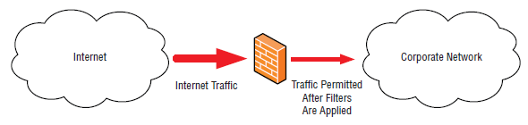
Type of Hardware firewalls and Characteristics
A firewall is a system that is designed to protect a computer or a computer network from network-based attacks. A firewall does this by filtering the data packets traversing the network.
A typical perimeter firewall is implemented with two (or more) network connections (see Figure 1)
  A connection to the network being protected
  A connection to an external network
Fig. 1 Example of a firewall implementation
Notes:
Firewalls remain the foundation of network security technologies.
There are a number of options, types, and technologies associated with selecting, implementing, and maintaining
The firewalls in a network.
There are also a number of factors that help determine the proper solution to meet business requirements.

Slide 5
Type of Hardware firewalls and Characteristics
Understanding Packet Filtering
Understanding Circuit-Level Firewalls
Understanding Application-Level Firewalls
Understanding Stateful Multi-level Firewalls
Notes:
Crystal Panek, page 140-143

Slide 6
Understanding When to Use a Hardware Firewall Instead of a Software Firewall
Host Firewall
Network Firewall
One type of software firewall is a firewall application installed on a host, used to protect the host from network-based attacks
Host firewalls are also known as personal firewalls.
The other type of software firewall is a firewall application installed on a server used to protect network segments from other network segments
The most popular network firewalls are those produced by Cisco

Slide 7
Understanding Stateful Inspection and Stateless Inspection
Stateful inspection also determines whether a packet is part of an existing session, and that information can be used to determine whether to permit or deny a packet
In addition to examining the header information of a packet traversing the firewall, a stateful inspection firewall also considers other factors when determining if traffic should be permitted across the firewall.
The firewall doesn’t consider any other information related to the packets when determining which packets are permitted to cross the firewall and which packets are blocked.
This type of data packet inspection is known as stateless inspection.

Slide 8
Using Isolation to Protect the Network
Understanding VLANs
  VLAN Membership by Port
  VLAN Membership by MAC Address
  Membership by IP Subnet Address
  Membership by Protocol
Understanding Routing
  The first method is to manually confi gure the routing table with the routes for each destination network (This is known as static routing).
  The second method for generating routing table information is to make use of a dynamic routing protocol. Because dynamic routing protocols are quite a bit more complex than static routing, we need to take a more in-depth look at the subject.
Understanding Routing Protocols (-)
  High Overhead - Not Scalable
  Network Bandwidth Intensive - Split Horizon
  Long Convergence Time - Split Horizon with Poison Reverse
  Routing Loop Issues
  Count-to-Infinity Issues (routing loops)
Notes:
+
>Smaller Routing Tables
>Highly Scalable
>More Efficient Use of Network Bandwidth
>Faster Convergence

Slide 9
Intrussion Detection System (IDS) & Intrusion Prevention System (IPS)
Intrusion detection systems (IDS) An IDS is a solution designed to detect unauthorized user activities, attacks, and network compromises
Intrusion Prevention Systems (IPS) is very similar to an IDS, except that in addition to detecting and alerting, an IPS can also take action to prevent the breach from occurring
Type of IDS/IPS:
  Network-Based
  Host-Based
Common deployment methodologies:
  Unfiltered
  Screened

Slide 10
Understanding Honeypots
One honeypot definition comes from the world of espionage, where Mata Hari-style spies who use a romantic relationship as a way to steal secrets are described as setting a ‘honey trap’ or ‘honeypot’.
A honeypot is a trap for hackers
There are a variety of different types of honeypots:
  Production
  Research
Types of honeypots that can be used to combat spam:
  Email Address Honeypot
  Email Open Relay Honeypot
Notes:
https://www.kaspersky.com/resource-center/threats/what-is-a-honeypot

Slide 11
Understanding DMZ
DMZ (Demilitarized zone), A DMZ Network is a perimeter network that protects and adds an extra layer of security to an organization’s internal local-area network from untrusted traffic. A common DMZ is a subnetwork that sits between the public internet and private networks.
Typical DMZ configurations encountered in production environments:
  Sandwich DMZ
  Single Firewall DMZ
Notes:
https://www.fortinet.com/resources/cyberglossary/what-is-dmz

Slide 12
Understanding NAT
Network Address Translation (NAT) is a technique used to modify the network address information of a host while traffic is traversing a router or firewall.
There are two main types of NAT:
  Static NAT
  Dynamic NAT

Slide 13
Understanding VPN
VPN (Virtual Private Network) is a technology that uses encrypted tunnels to create secure connections across public networks like the Internet
The first standards-based VPNs were based on the IPsec protocol
There are two main types of NAT:
  Static NAT
  Dynamic NAT

Slide 14
Understanding Other VPN Protocols
The SSL protocol standard was originally proposed as a standard by Netscape. While this protocol is widely used to secure websites, it has since been formalized in the IETF standard known as Transport Layer Security (TLS).
The SSL/TLS protocol provides a method for secure client/server communications across a network and prevents eavesdropping and tampering with data in transit.
SSL/TLS also provides endpoint authentication and communications confidentiality using encryption.
Secure Sockets Layer (SSL)/Transport Layer Security (TLS)
  Secure Shell (SSH)

Slide 15
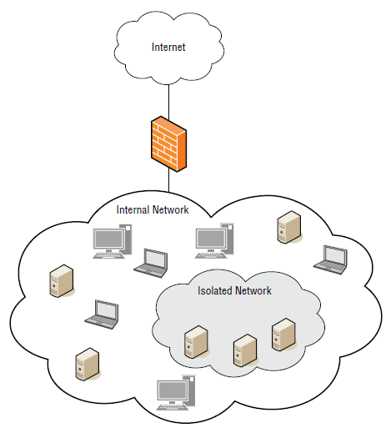
Understanding Server and
Domain Isolation
Security professionals are constantly being asked by businesses to allow greater and greater access to resources in order to facilitate business requirements
Server and domain isolation is a solution based on IPsec and the Microsoft Active Directory that enables administrators to dynamically segment their Windows environment into more secure and isolated logical networks.
Fig 2 An example of server and domain isolation

Slide 16
References
Panek, Crystal. (2019). Security Fundamental, John Wiley & Sons, Inc. Indianapolis. ISBN: 978-1-119-65066-9
Stallings, William and Lawrie Brown. 2018. Computer Security: Principles and Practice, 4th Edition. Global Edition, Pearson Education Limited
https://www.fortinet.com/resources/cyberglossary/what-is-dmz
https://www.kaspersky.com/resource-center/threats/what-is-a-honeypot
Notes:
Resources:
https://www.cloudflare.com/learning/ddos/glossary/open-systems-interconnection-model-osi/
https://www.cloudflare.com/learning/ddos/glossary/open-systems-interconnection-model-osi/
https://learningnetwork.cisco.com/s/contentdocument/0693i000001r6HTAAY
https://www.cloudflare.com/learning/network-layer/what-is-ipsec/
https://www.hypr.com/security-encyclopedia/transport-mode#:~:text=Transport%20Mode%20is%20a%20method,Transport%20Mode%20or%20Tunnel%20Mode.
https://www.ibm.com/docs/en/zos/2.2.0?topic=encapsulation-transport-mode-tunnel-mode
https://docs.oracle.com/cd/E36784_01/html/E36838/ipsecov-13.html
https://www.hypr.com/security-encyclopedia/tunnel-mode#:~:text=Tunnel%20Mode%20is%20a%20method,address%20information%20is%20also%20encrypted.

